Slide 1


Data Analysis of Overhangs and Slabs in Bouldering
Ege Aral Aksoy 28589

Slide 2

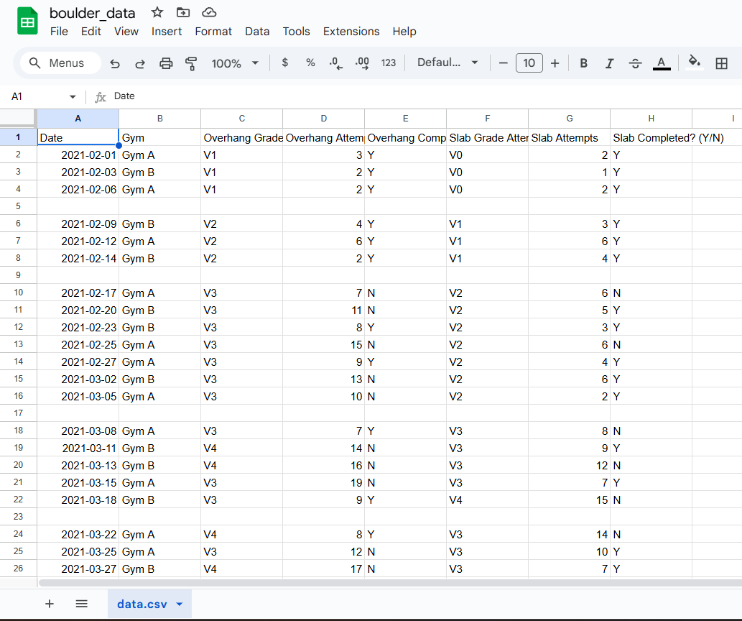
Gathering of Data
The data was gathered for a period of 11 months via Top Logger: which takes a record of all the boulders attempted, whilst keeping their grades, how many attempts it took you to finish and what type of boulder it is along with the gym where it was logged. This data is kept in csv format however was transformed into an excel file for ease of understanding.

Slide 3
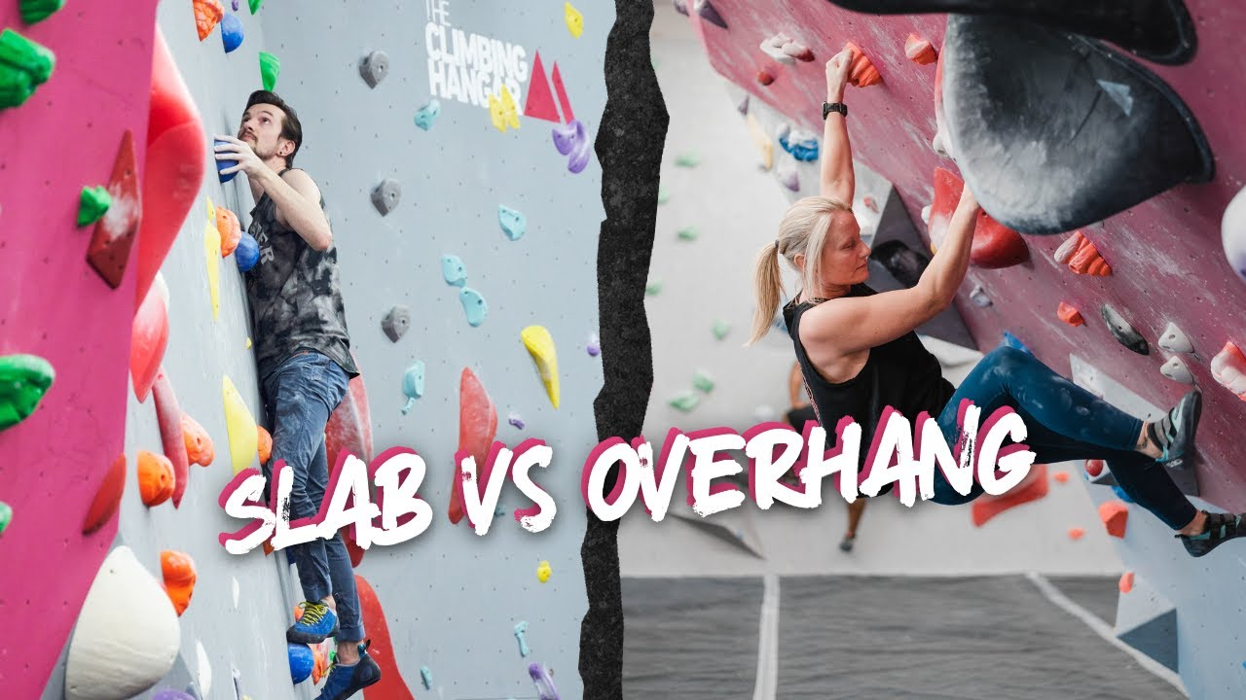
Hypothesis
As time goes on, the data will show slabs becoming easier compared to overhangs.
This is due to my already muscular built from previous sports experience. Since overhangs require more strength relative to technique overhangs should be easier compared to slabs early on. However, as I understand bouldering and technique more later slabs will become easier since it doesn’t require muscles to be good at which I additionally already have.

Slide 4
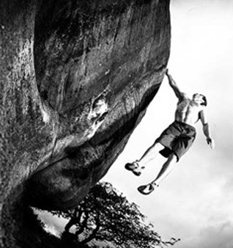
What Will the Conclusive Data Analysis of Overhangs and Slabs Consist of?
Progression of Monthly Average Grades
Completion by Grade
Attempts Correlation
Heatmap
Highest Grade Each Month & Fewest Attempts
Gym Comparison

Slide 5
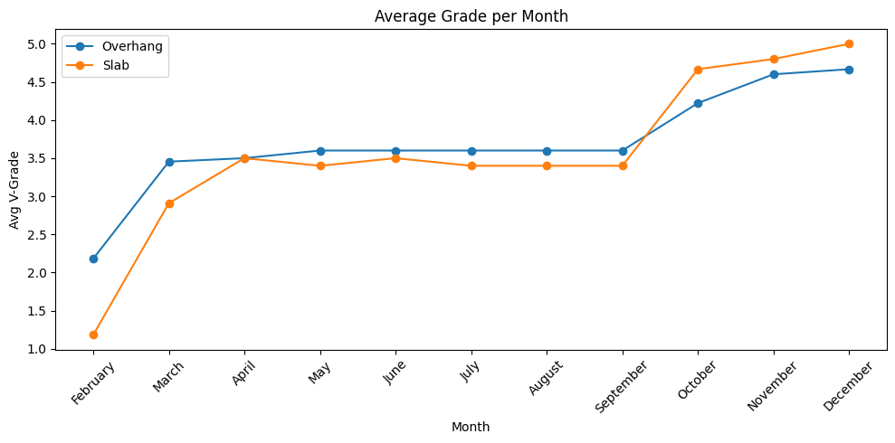
Progression of Monthly Average Grades
During the February - March Overhangs had a higher average grade compared to slabs which shows It was easier to complete overhangs initially.
April – September however has different results. The average grades equal out hence it shows that there is a faster rate of improving at slabs compared to overhangs.
Finally for months 8 – 11 slabs have overtaken overhangs in avg Difficulty.
This shows that the hypothesis is aligned with the data.

Slide 6
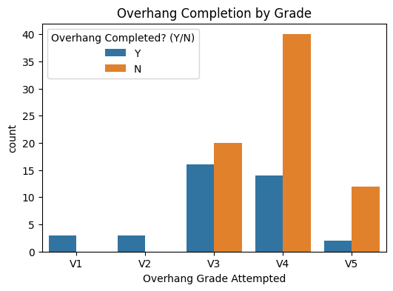
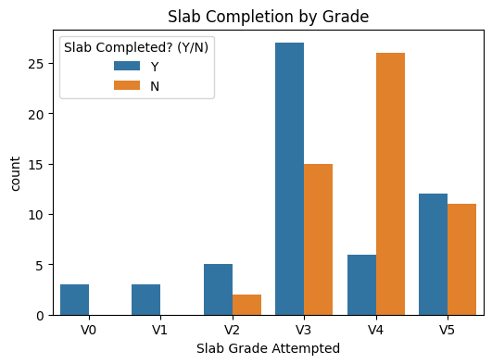
Completion by Grade
The climbs for Overhang initially look simpler and easier for me as seen by the data having less attempts for it to finish relative to slabs for v1 and v2 even being able to skip v0.
However, as months progress the data shows that there is an increased success with slab routes since it takes overhang more attempts to not even be able to successfully complete the boulder.

Slide 7
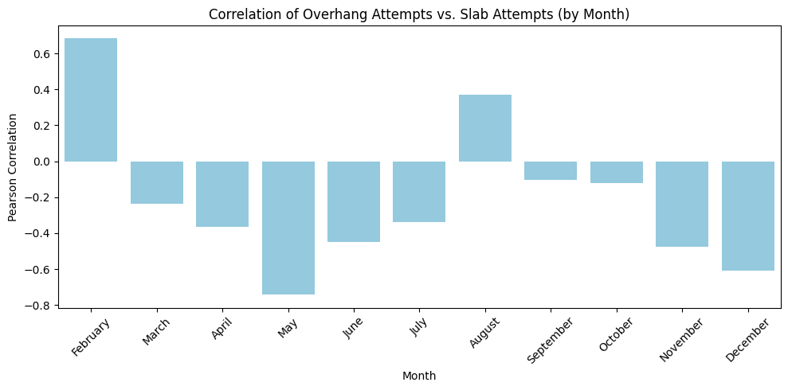
Attempts Correlation
In the graph when overhang attempts go up, slab attempts also go up hence there being a positive or negative correlation.
When it is positive it suggests that in the same month I focus both overhangs and slabs the same, and it being the opposite for negative.
This finding shows that the hypothesis is partially true because the reason why I improved at slabs is not only because I already had a muscular build but also because I attempted more slabs compared to overhangs.

Slide 8
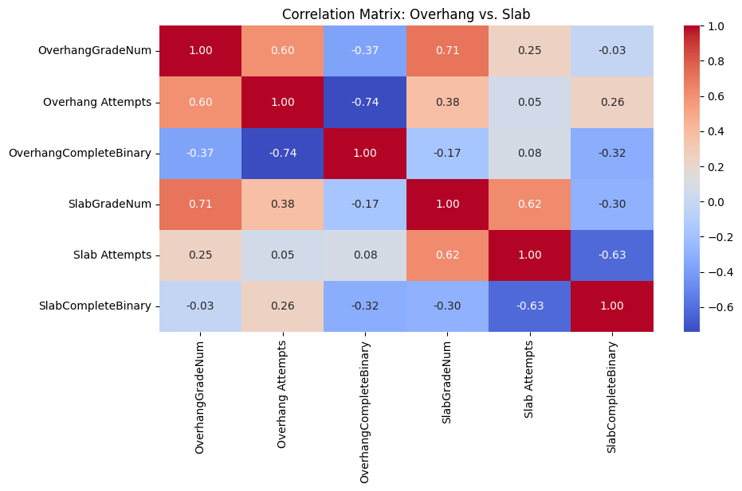
Heatmap
Heatmap Conclusions:
More difficult climbs require more attempts however they still have less completion rates relatively to easier climbs.
The heatmap aligns with the idea that a muscular foundation does help early on with overhangs but technique and attempts management for a slab especially become important as the grades increase.

Slide 9
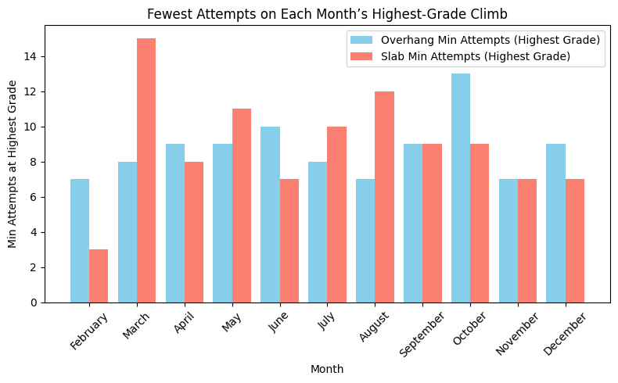
Highest Grade Each Month & Fewest Attempts
This chart shows that there are fluctuations within how some months slabs might finish easier, but some months overhangs might.
This reflects that sometimes a specific route deemed to be a certain difficulty might actually not be that difficult which does also create another variable which can't be controlled within this analysis.

Slide 10
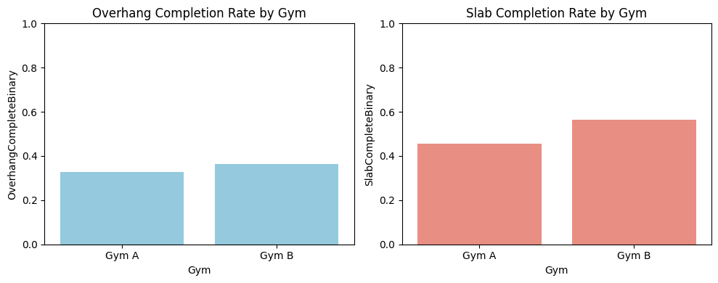
Gym Comparison
Gym B has higher completion rates relative to gym A which indicates that gym B is an easier gym compared to A. This also points out that the “said difficulty” in each gym is not on the same standard hence skewing the hypothesis.

Slide 11
In Conclusion
The hypothesis still stands however it is not as reliable as it first seemed due to uncontrollable environments such as the subjective difficulty of the climb, that more slabs were practiced relative to overhangs thus making the analysis seem more in favor with the hypothesis than it might have been and the two gyms having different success rates.

Slide 12
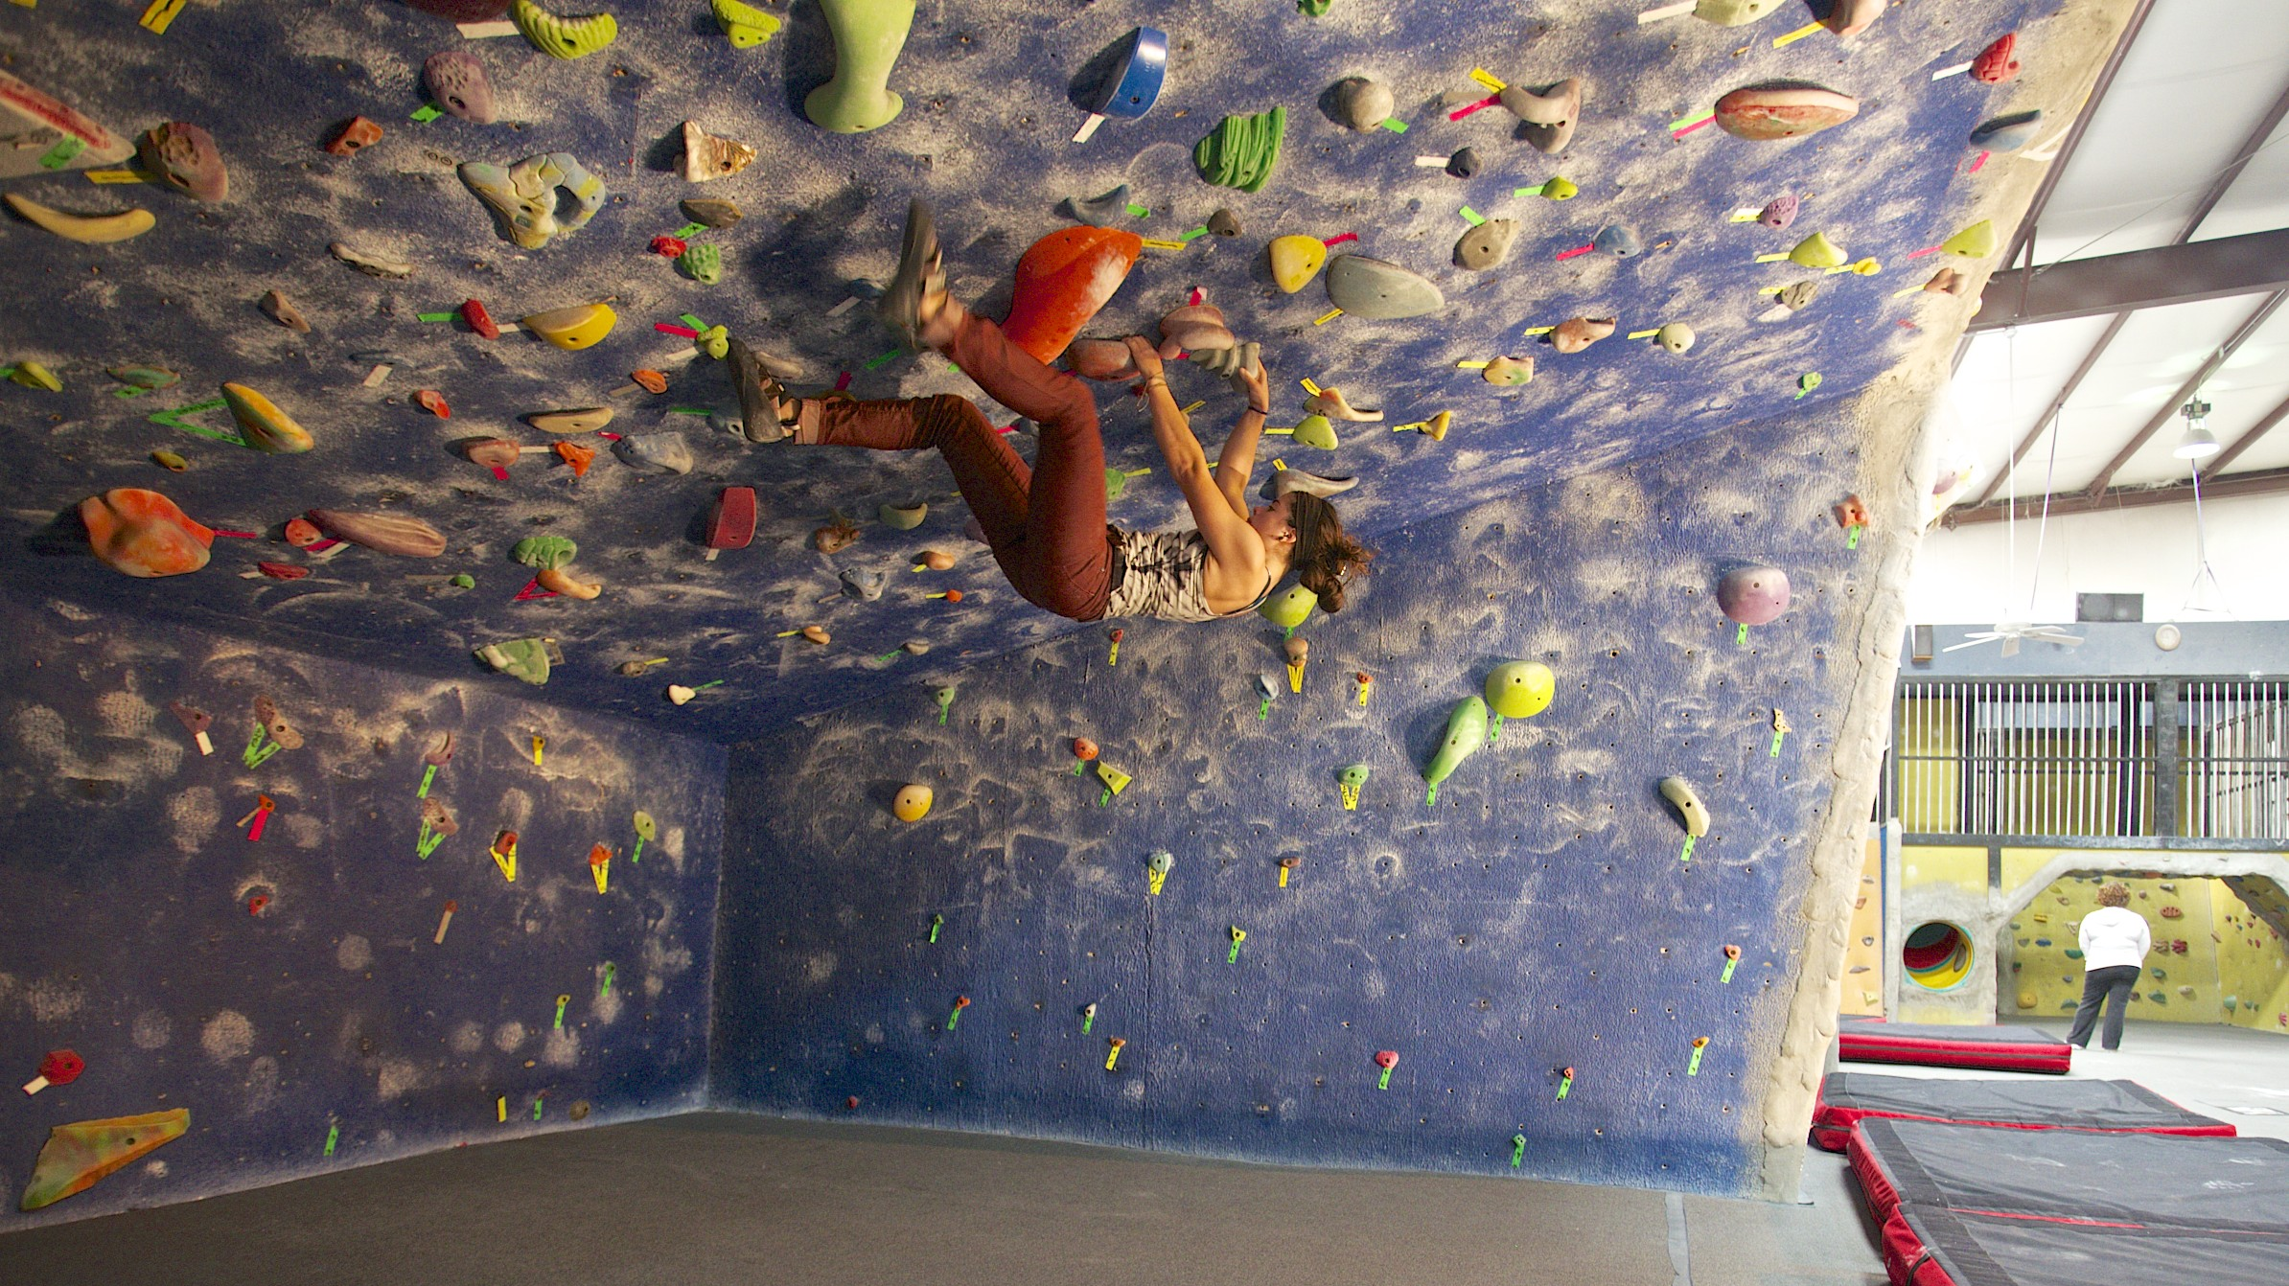
Thank you for your time.
Ege Aral Aksoy

